Slide 1
Hindsight Experience Replay ^{[1]}
A tutorial with examples
Achin Jain

Slide 2
1. Reinforcement Learning 101

Slide 3
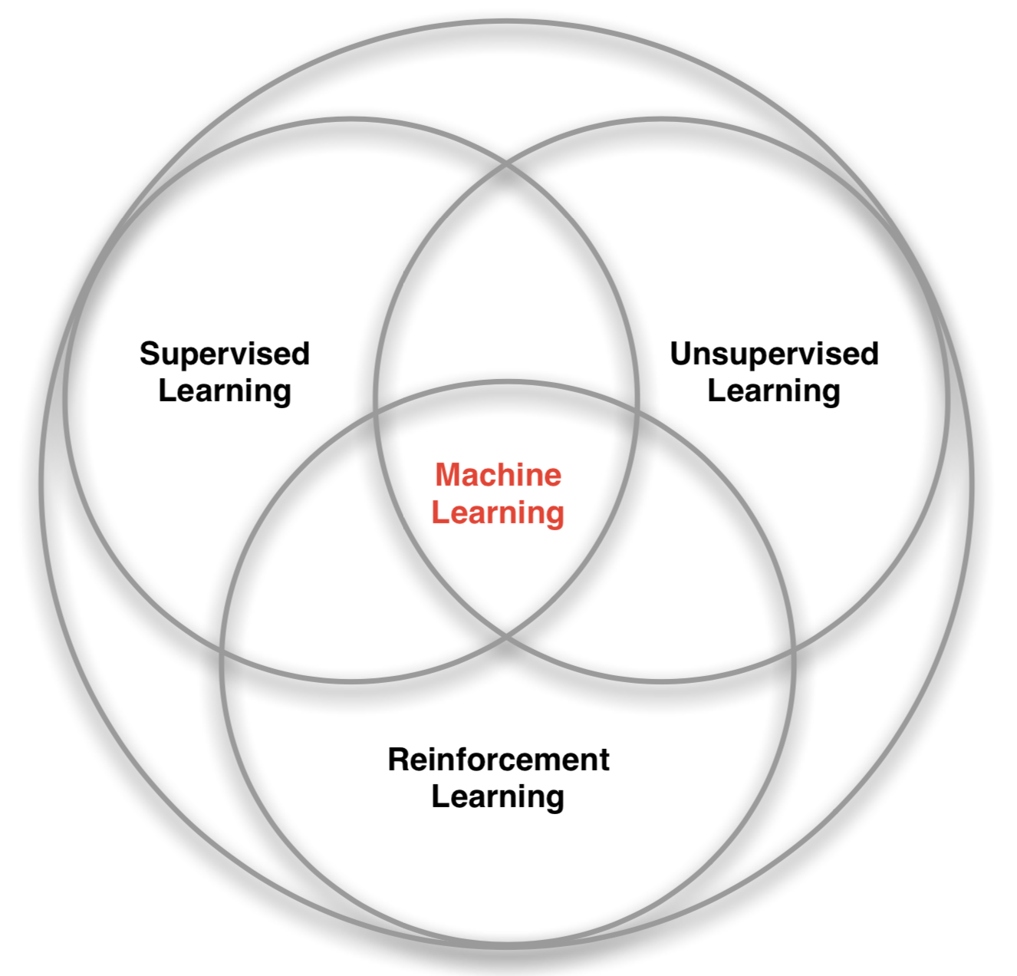
Branches of machine learning
Slide from David Silver’s RL course [2]

Slide 4
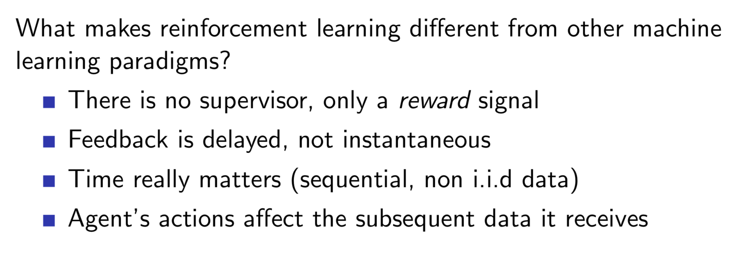
What makes RL different?
Slide from David Silver’s RL course [2]
Notes:
Trial and error, nobody tells what’s the best decision. We define rewards singnals.
We have a dynamical system, what we do changes what data we see next

Slide 5
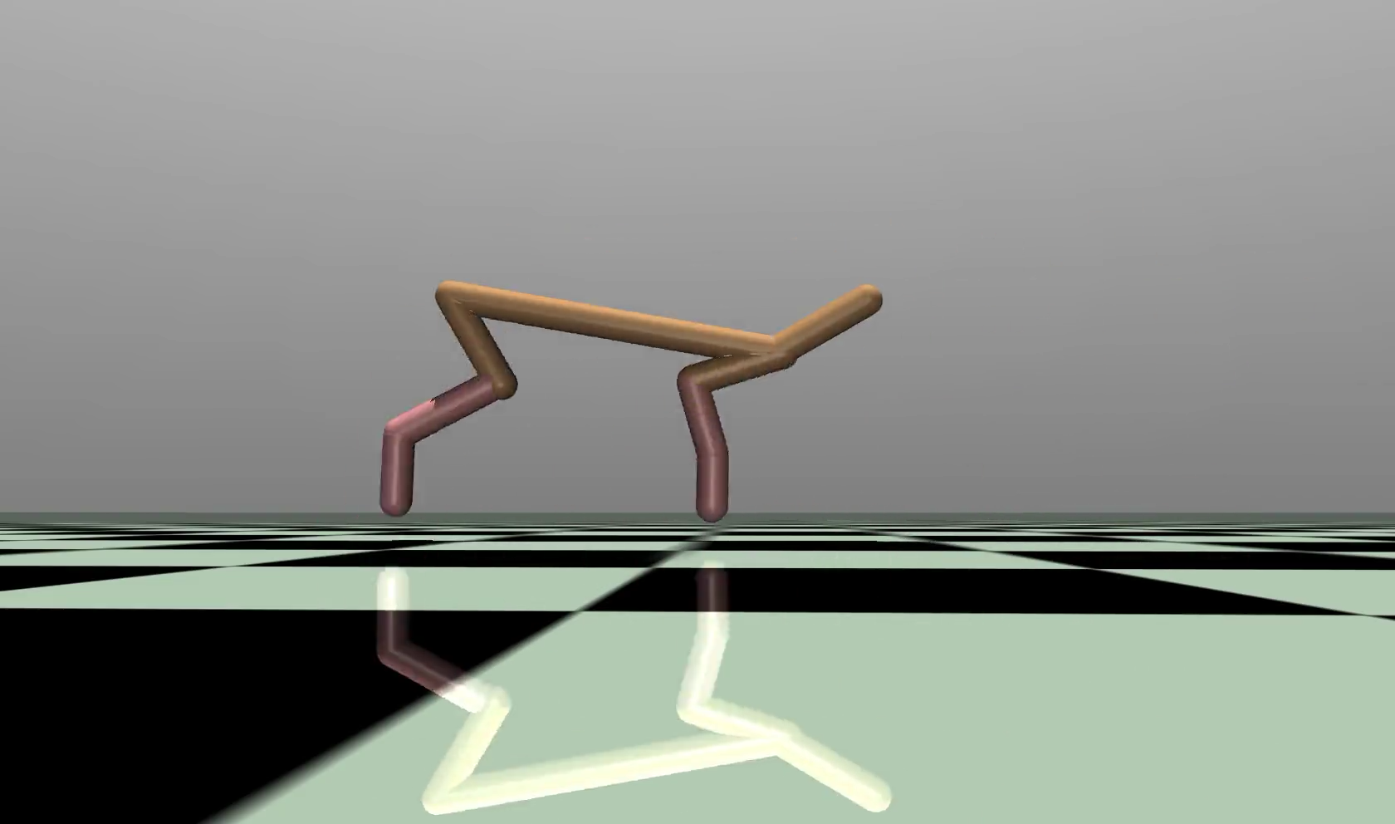
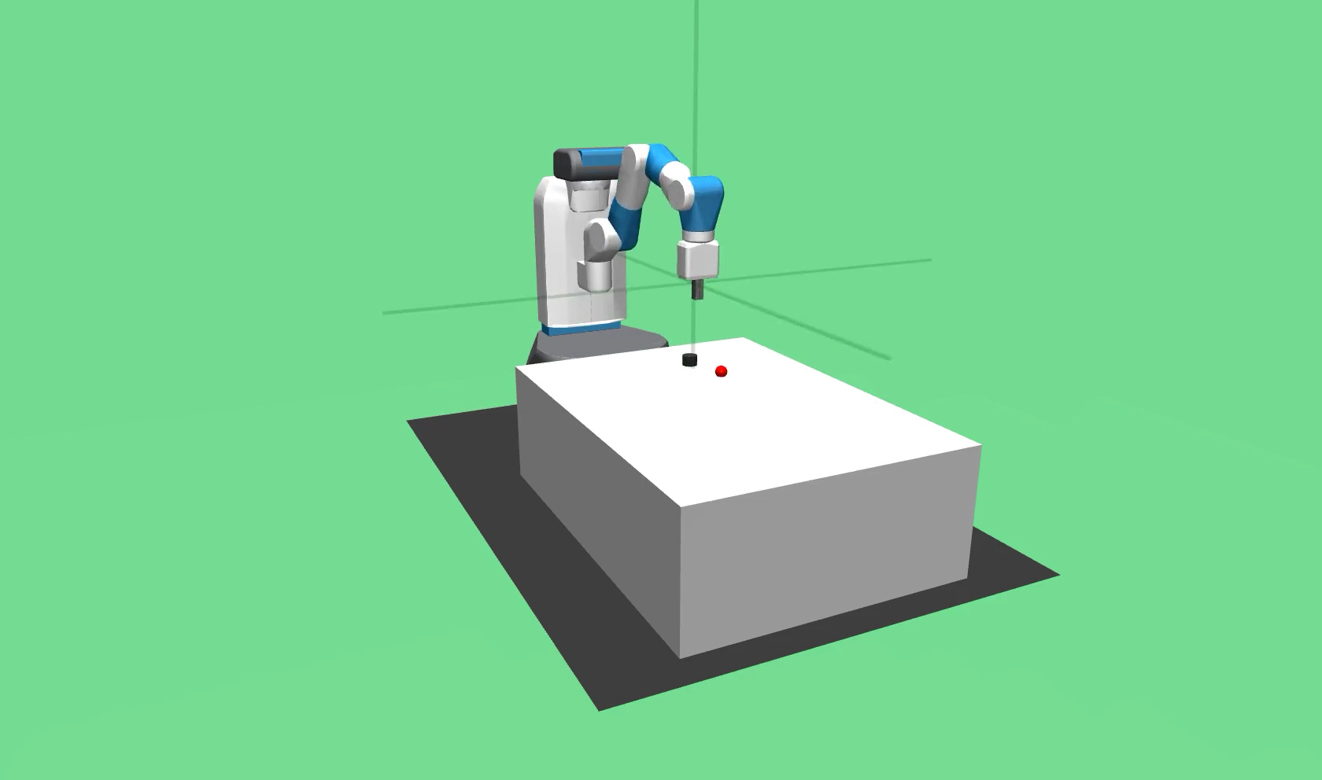
HalfCheetah Train a 2D cheetah to run
FetchSlide Slide a puck to a goal position
Notes:
What is the goal? What are control actions? What is a reward?

Slide 6
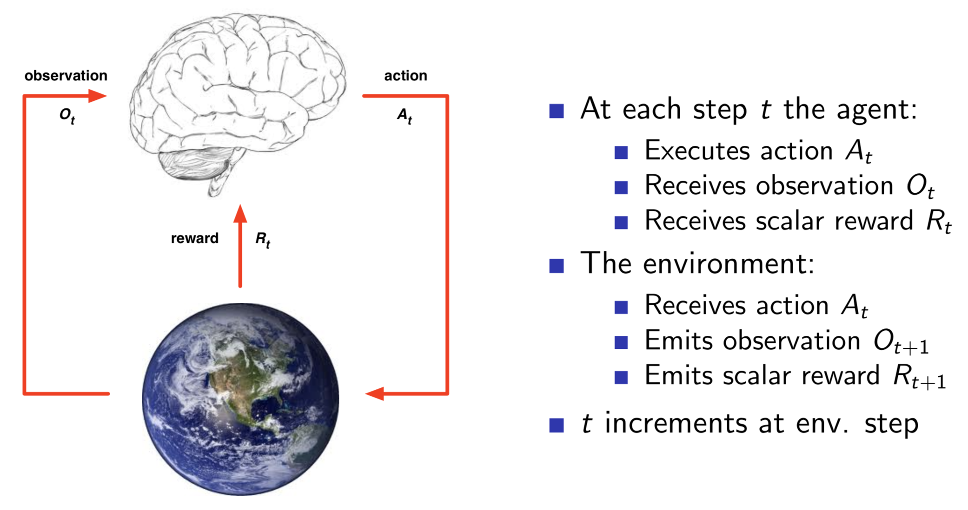
Agent and environment
Slide from David Silver’s RL course [2]

Slide 7
Agent and environment
We train an agent, example a neural network
We choose a reward function,
with a scaler output
THE GOAL IS SELECT ACTIONS THAT MAXIMIZE CUMULATIVE REWARDS
Slide from David Silver’s RL course [1]
Notes:
Now the question obviously is how do we select actions? Who gives us rewards?

Slide 8
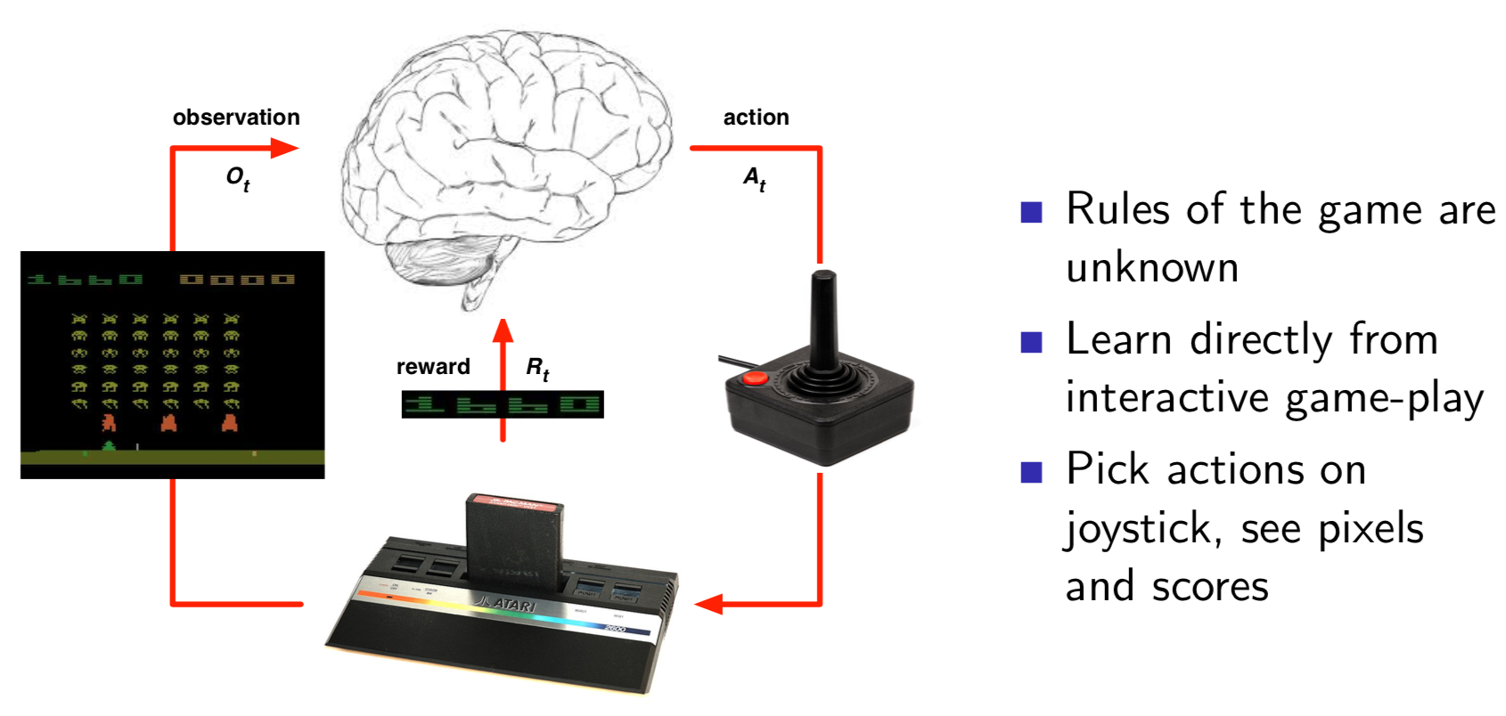
Atari example
Slide from David Silver’s RL course [2]

Slide 9
HalfCheetah Train a 2D cheetah to run
FetchSlide Slide a puck to a goal position
Notes:
Robotics example is somewhat different from HalfCheetah. There is a notion of what the goal is, what we classify as success.

Slide 10
2. RL Algorithms

Slide 11
Discrete action space
Small no of states and actions
Dynamic Programming (DP)
Monte-Carlo (MC)
Temporal Difference TD (λ)
Q-learning (off-policy)
Large-scale
Deep Q Networks (DQN) [5]

Slide 12
Continuous action space
Monte-Carlo policy gradient (REINFORCE)
Actor critic
Very recent developments
Deep deterministic policy gradients (DDPG) [6]
Proximal policy optimization (PPO) [7]
Twin delayed DDPG (TD3) [8]
Soft actor critic (SAC) [9]

Slide 13
Ingredients of an RL problem
 | Atari | Half Cheetah | Fetch Slide
Environment space | Images | Position and velocity of joints | Pose, velocity of object and end effector
Action space | Joystick actions (discrete) | Joint torques (continuous) | Δx, Δy, Δz of end effector (continuous)
Reward function | Difference in score at any time (given) | func(velocity, torques) (designed) | func(desired, achieved goal) (designed)
Modeling framework | Game engine (rules unknown) | MuJoCo (physics known in sim) | MuJoCo (physics known in sim)
Learning algorithm for agent | DQN | DDPG, PPO, etc. (and many more) | DDPG + HER

Slide 14
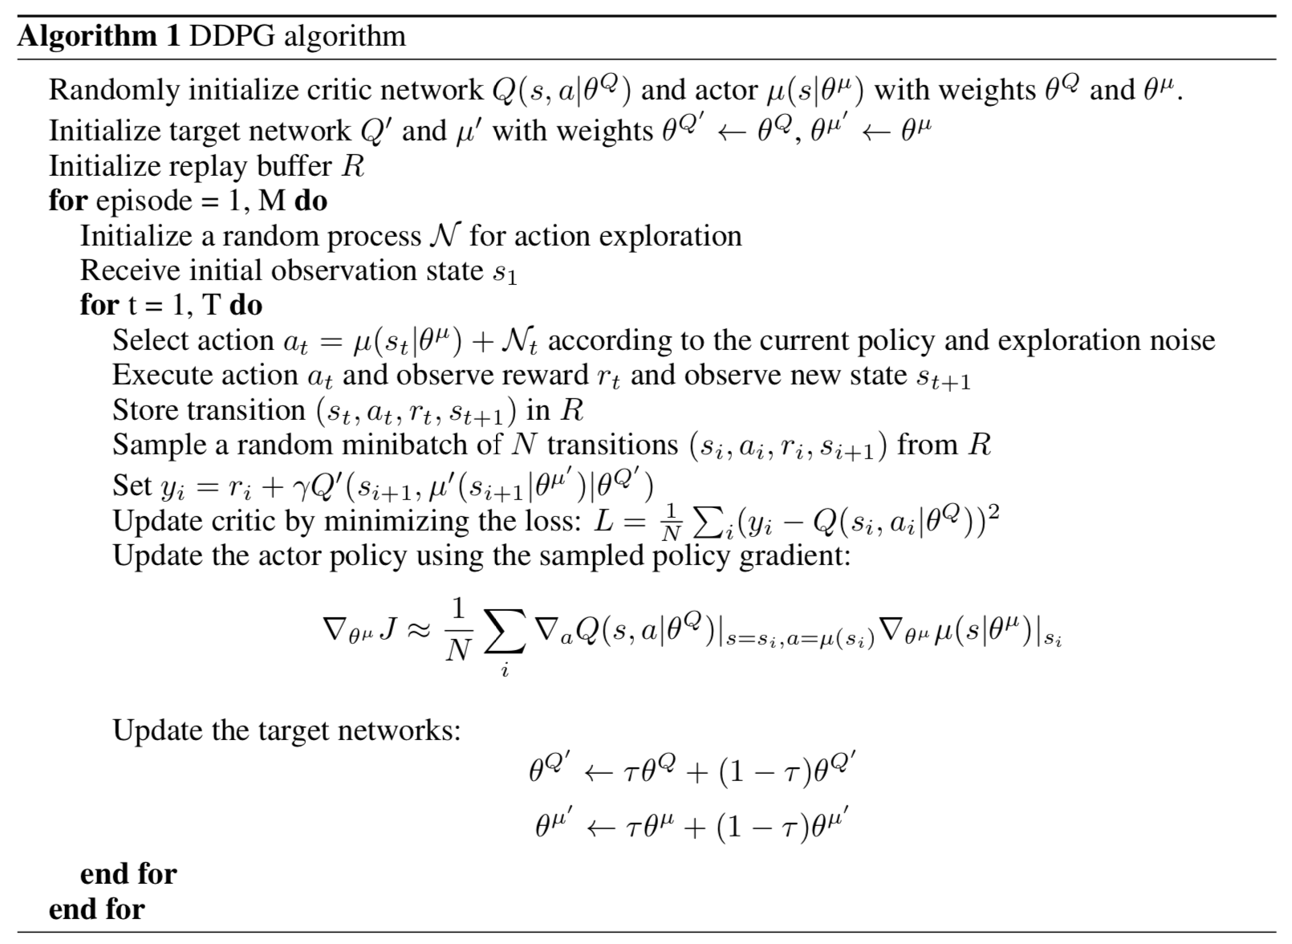

Slide 15
3. Hindsight Experience Replay

Slide 16
Motivation
Designing reward function is challenging
Requires RL expertise and domain specific knowledge
What if we could only learn from binary signals, like success or failure?
Many applications with sparse rewards, i.e. observe successes very rarely
This significantly reduces the rate of learning with naïve use of continuous control algorithms like DDPG, PPO
Image from OpenAI [4]
Notes:
Remember there is no supervisor, we shape the reward function. And this guides the training of the policy.

Slide 17
Goal oriented problems and HER
Desired goal: target location of the object
Achieved goal: current position of the object
HER learns from failures
Pretend what we achieved is what we desired to achieve
Add failed experiences to replay buffer by modifying rewards
Thus, learn to achieve arbitrary goals!
Can combine with any off-policy RL algo
Image from OpenAI [4]

Slide 18
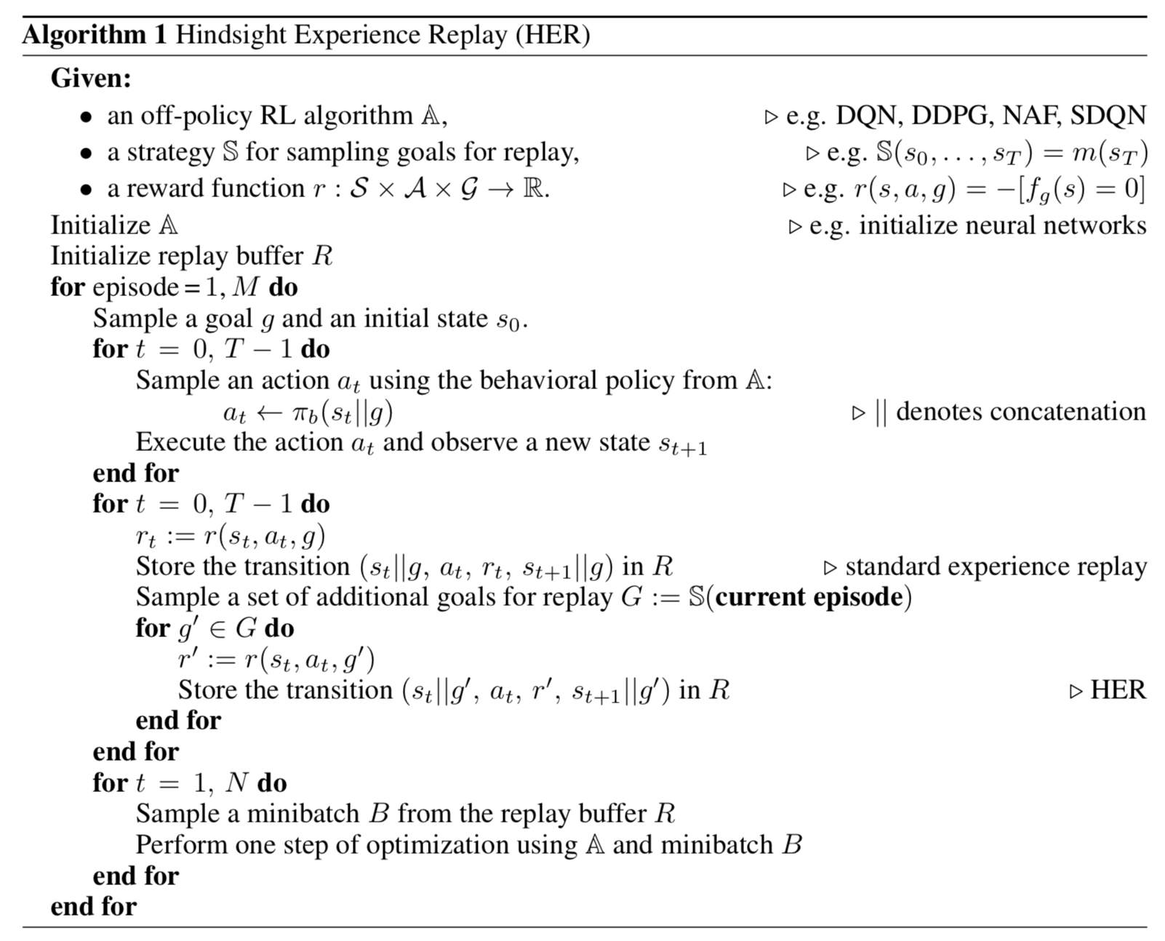

Slide 19
4. Case study
Robotic Manipulation

Slide 20
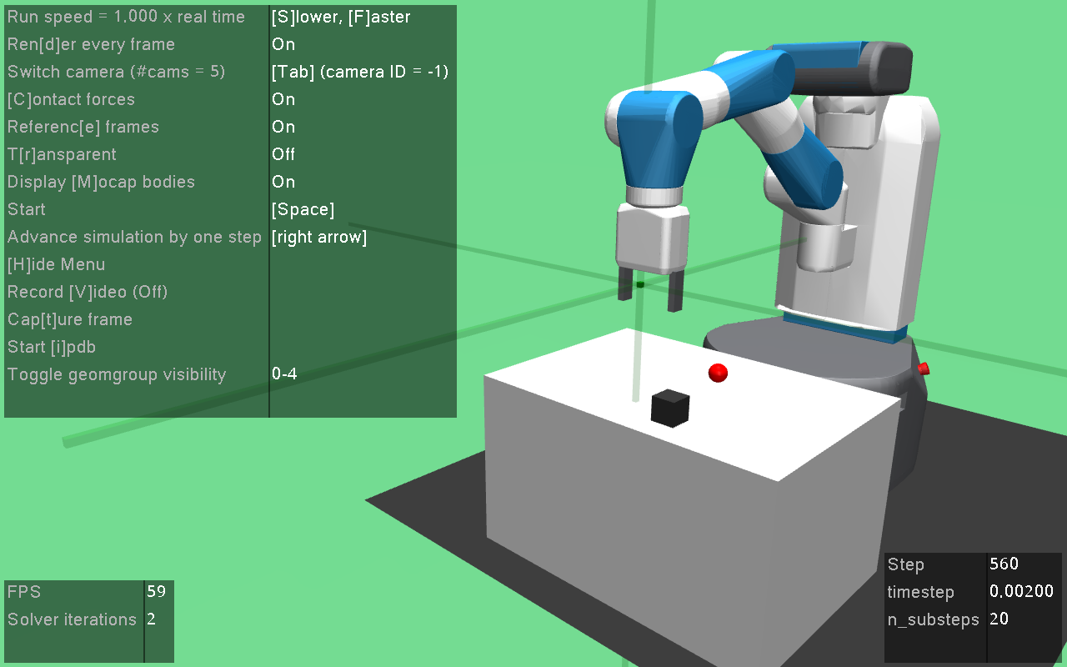

Slide 21
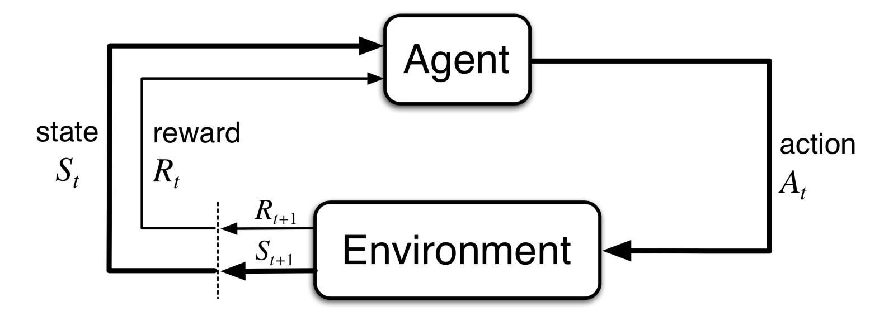
Agent and environment
DNN
Sutton and Barto, 2018
STATES:
1. end effector pos, vel
2. gripper state, vel
3. object pos, rot and vel
4. relative pos and vel
ACTIONS:
Δx, Δy, Δz
of the end-effector
gym
REWARDS:
0 if the object is near the target, -1 otherwise
NOTE: SPARSE REWARDS

Slide 22
gym ^{[10]} A toolkit from OpenAI to develop and compare RL algorithms
ImageNet : Supervised Learning :: Gym : Reinforcement Learning
It provides the environment, you design the algorithm (agent)!
A collection of large and diverse collection of standard environments
Examples include Atari games like pong, space invaders, control theory problems like cart pole, inverted pendulum, robotics applications like robotic manipulation, in-hand object manipulation, etc.
Researchers can design and compare their RL algorithms on the same environments

Slide 23
MuJoCo ^{[11]} A physics simulation engine for multi-joint dynamics with contacts
mujoco_py: python wrapper built by OpenAI, can be used with gym
MuJoCo is faster and more accurate for robots with multiple joints [12]
Soft contact modeling as opposed to others
Other simulators include DART, bullet etc
Free license for academic research

Slide 25
Deep deterministic policy gradients (DDPG)
Actor-critic method for continuous action spaces
Actor (policy network): 3 layers, 256 neurons
Critic (Q value network): 3 layers, 256 neurons
OpenAI Baselines implementation of DDPG + HER [13]
See all hyperparameter settings in [13]

Slide 26
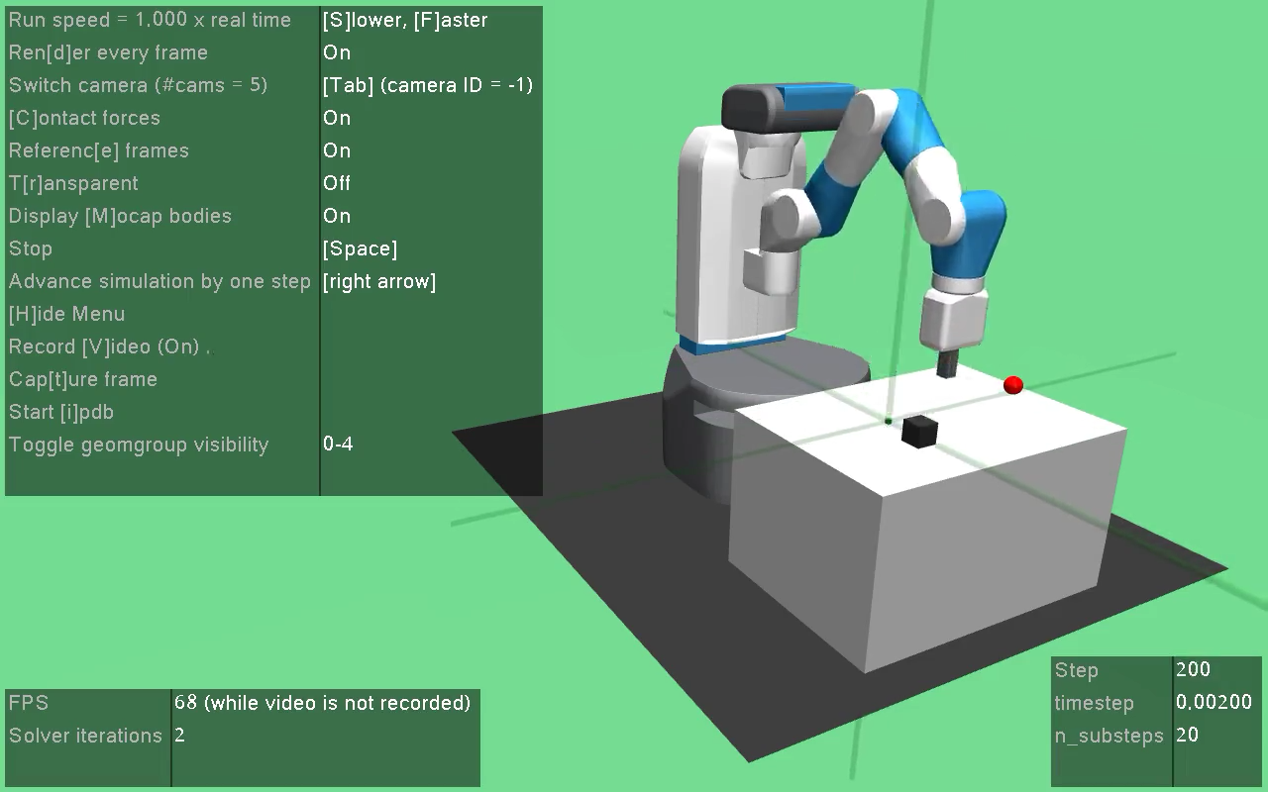

Slide 27
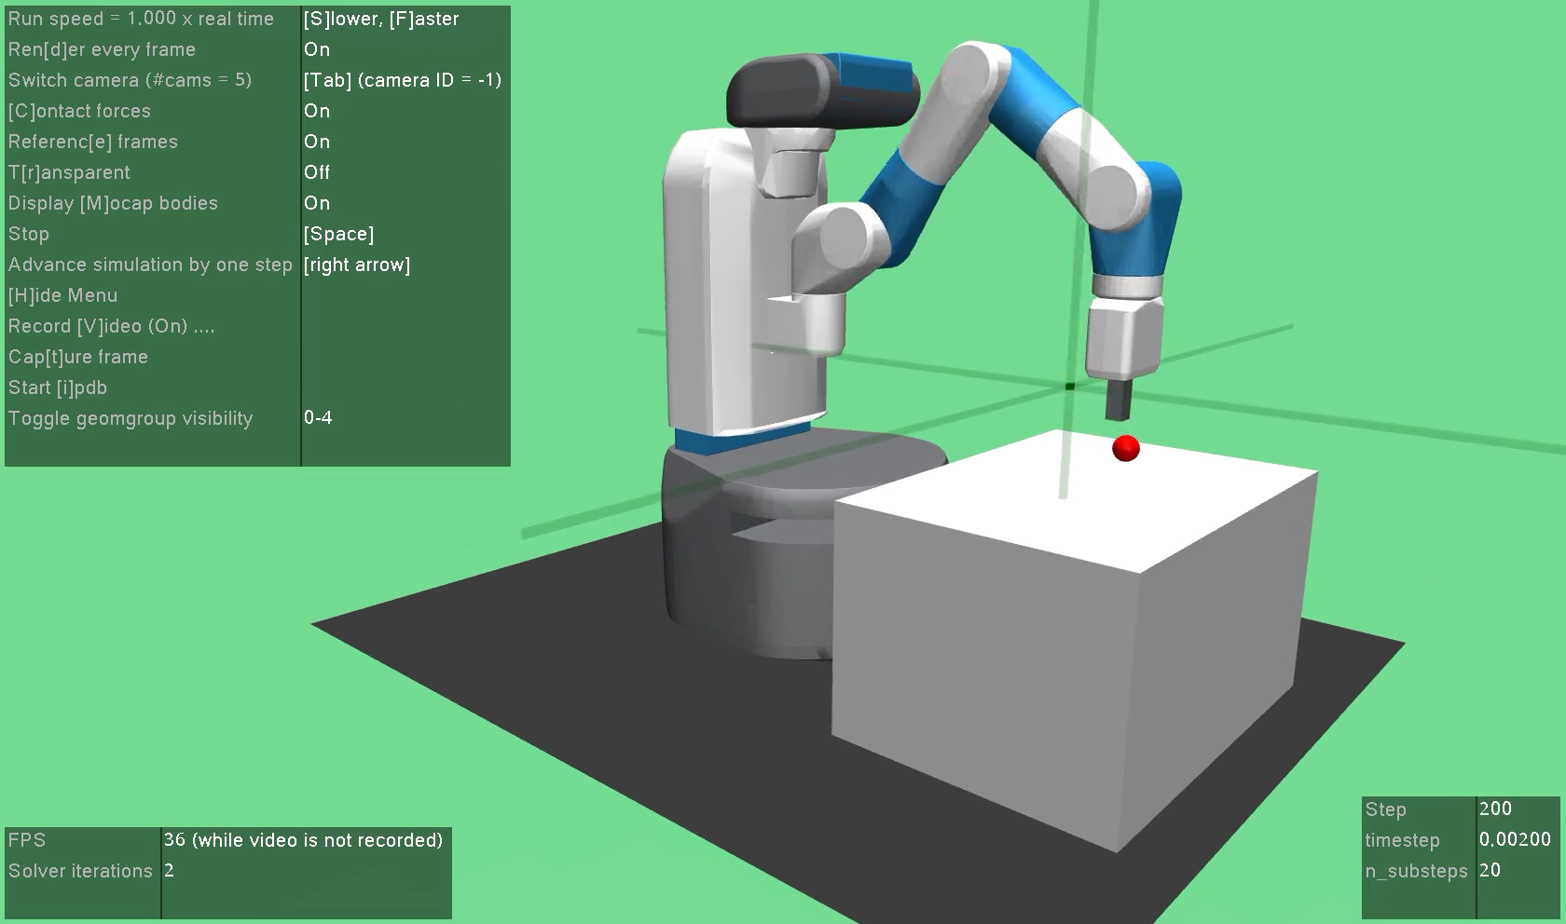
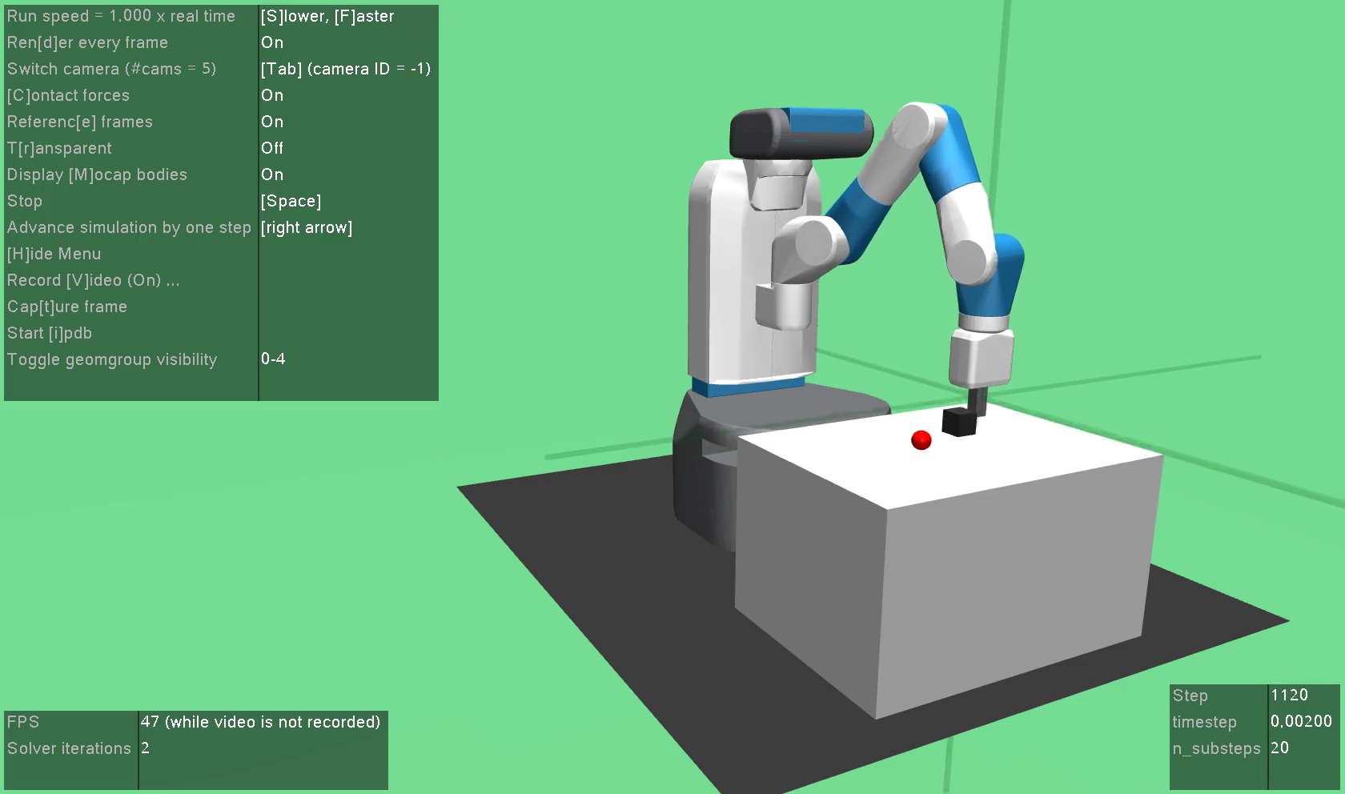
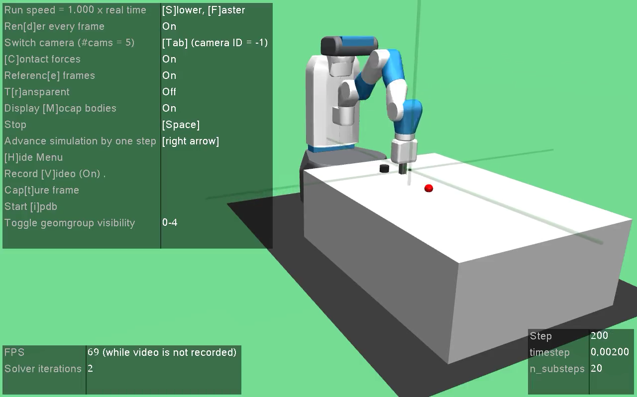

Slide 28
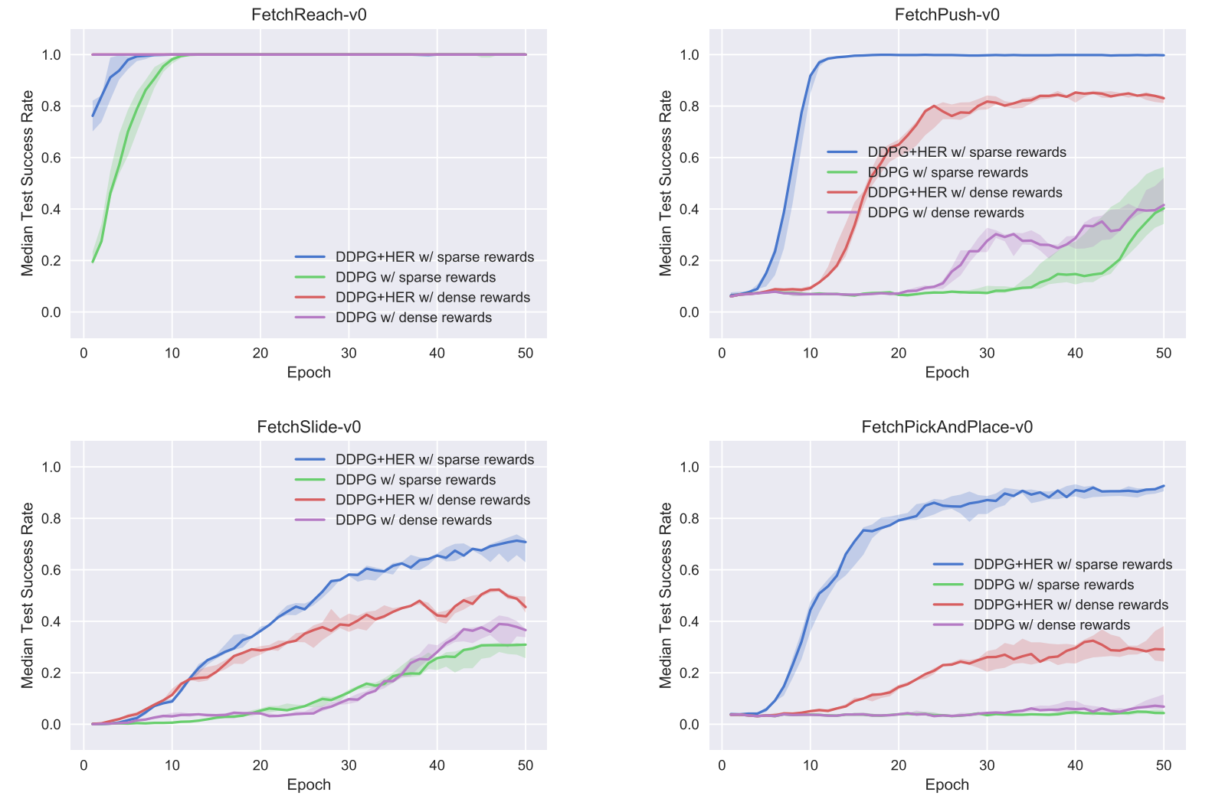
Source [14]

Slide 29
More examples

Slide 30
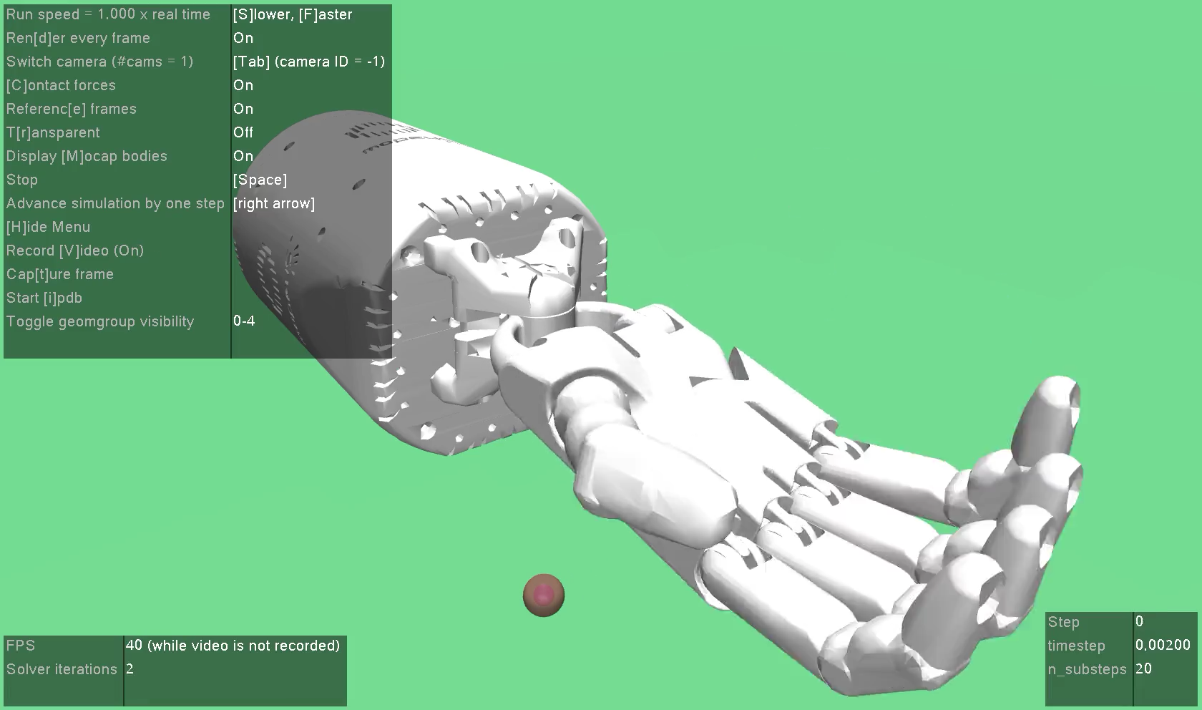
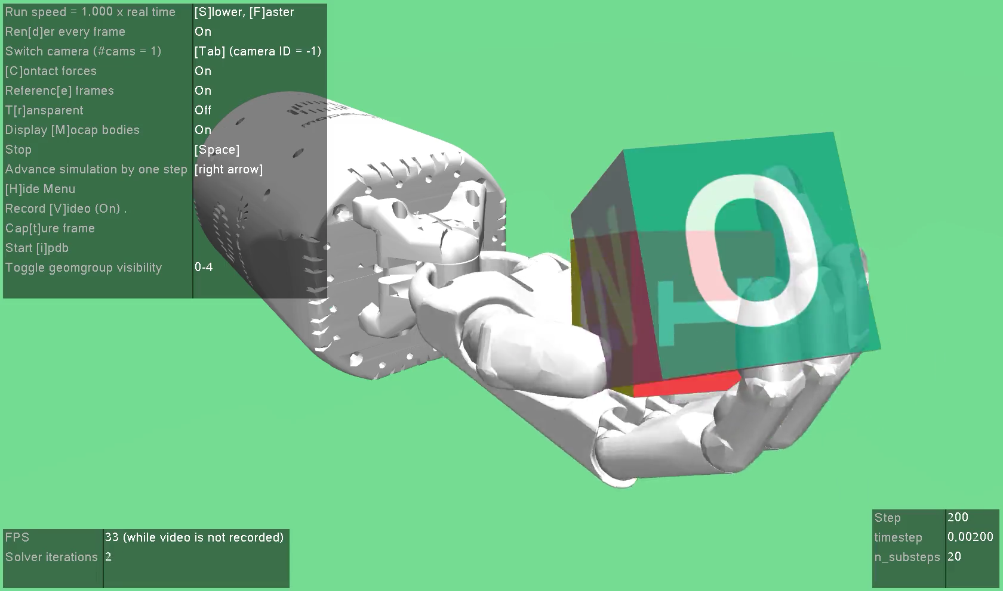
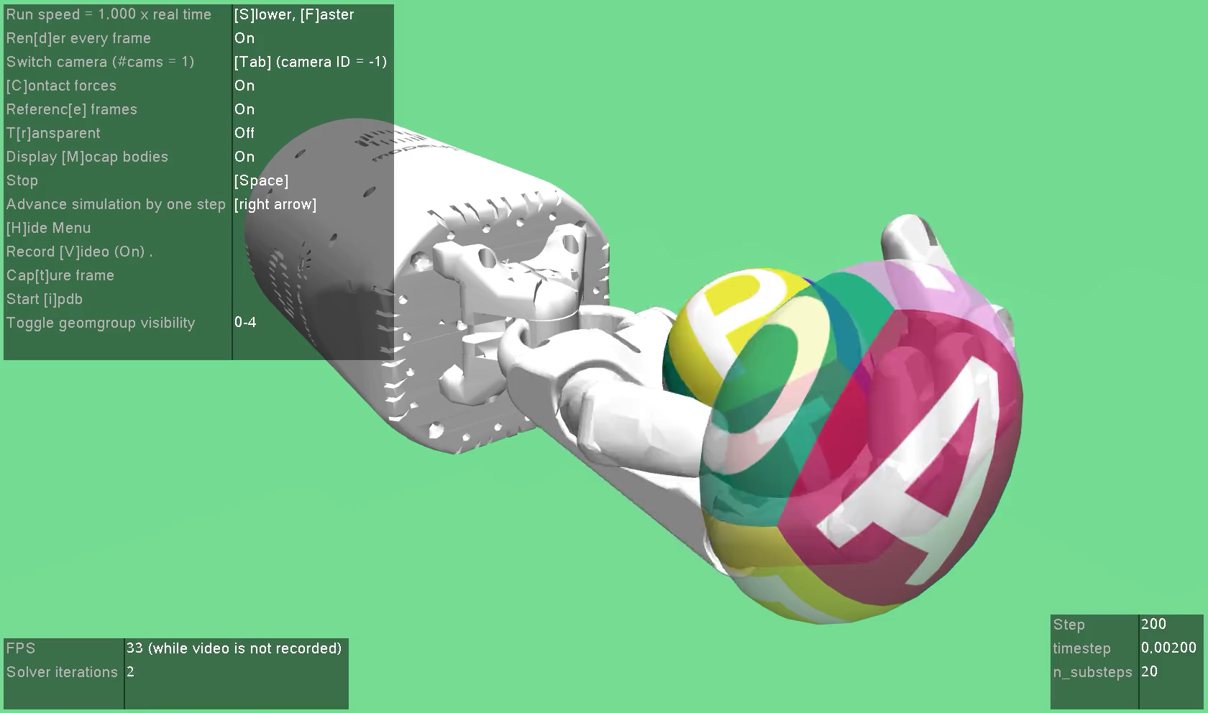
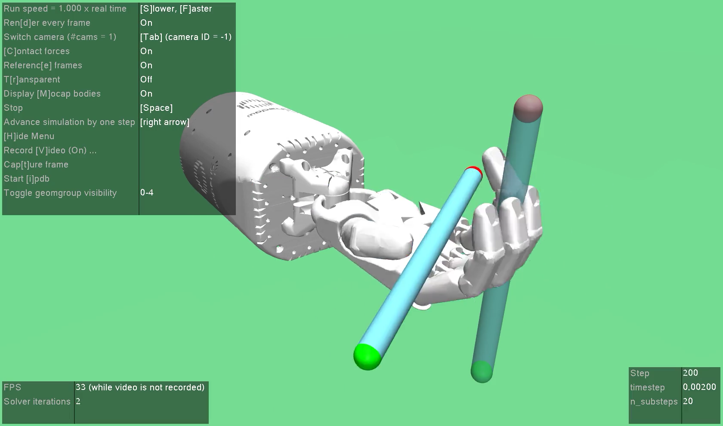

Slide 31
References

Slide 32
References
OpenAI. Hindsight experience replay, NIPS, 201
David Silver. UCL Course on Reinforcement Learning, 2015. http://www0.cs.ucl.ac.uk/staff/D.Silver/web/Teaching.html
OpenAI. Official Gym Environments, 2019. http://gym.openai.com/envs/
OpenAI. Ingredients for Robotics Research, 2018. https://openai.com/blog/ingredients-for-robotics-research/
DeepMind. Human-level control through deep reinforcement learning, Nature, 2015.
DeepMind. Continuous control with deep reinforcement learning, ICLR, 2016.
OpenAI. Proximal Policy Optimization Algorithms, 2017. https://arxiv.org/abs/1707.06347
Fujimoto et al. Addressing Function Approximation Error in Actor-Critic Methods, ICML, 2018.

Slide 33
References
Haarnoja et al. Soft Actor-Critic: Off-Policy Maximum Entropy Deep Reinforcement Learning with a Stochastic Actor, 2018.
Brockman et al. OpenAI Gym, 2016. https://github.com/openai/gym
Todorov et al. MuJoCo: A physics engine for model-based control, International Conference on Intelligent Robots and Systems, 2012. http://www.mujoco.org/
Erez et al. Simulation tools for model-based robotics: Comparison of Bullet, Havok, MuJoCo, ODE and PhysX, ICRA, 2015.
Dhariwal et al. OpenAI Baselines, 2017. https://github.com/openai/baselines
Plappert et al. Multi-Goal Reinforcement Learning: Challenging Robotics Environments and Request for Research, 2018. https://arxiv.org/pdf/1802.09464.pdf

